Slide 1

Random Forest
Ensemble machine learning algorithm
Sergey Rogachevsky, 7104711

Slide 2

Content:
Abstract
Usage domain
Precursor: decision tree
Simplified decision algorithm
Advantages
Disadvantages
Random forest(RF) building pseudocode
Required amount of features dependency
Dependency of average error from amount of trees
Random forest algorithm
Conclusion
References

Slide 3
Abstract
RF - Type of supervised machine learning algorithm known as ensemble methods
Decision tree as a base for development random forest
Uses random sampling data to create various input dataset to make final decision

Slide 4
Usage domains:
Banking sector: finding loyal customers
Medicine: grinding correct combination of components
Computer vision: image classification

Slide 5
Precursor: decision tree
Advantages:
Easy to build
Easy to use
Easy to interpret
Disadvantages:
Sometimes calculations take too much effort
They don’t classify new samples

Slide 6

Simplified decision algorithm
The image from https://en.wikipedia.org/wiki/Random_forest

Slide 7
Advantages
Can be used in both classification and regression task
Can handle missing values
Maintain accuracy for missing data
Will not overfit the model
Handle large datasets with high dimensionality
Random forests generally outperform decision trees
Helps with feature selection based on importance
Notes:
Classification - spam or not spam, cat or dog

Slide 8
Disadvantages
Not the best performance at regression
Low level of control over the models
Data characteristics can affect their performance
Lower accuracy compared to gradient boosted trees

Slide 9
Random forest building pseudocode
let m = amount of features
let N = amount of random forest trees
for i:=0 to N do
start a new Bootstrap-training Dj
for each training choose random features m’<=m, which will be used for path’s division in tree
add Dj to collection of trees
end of

Slide 10
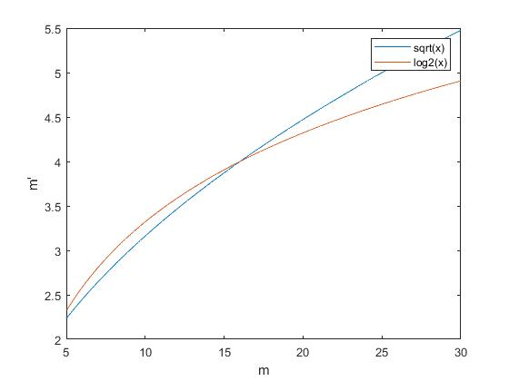
Required amount of features dependency
Classification: m’ = sqrt(m)
Regression: m’=log2(m)

Slide 11
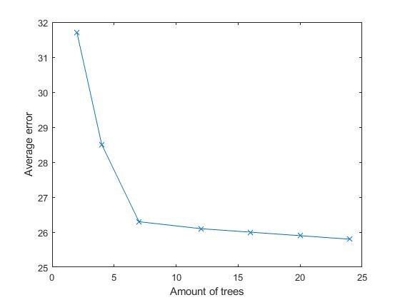
Dependency of average error from amount of trees

Slide 12
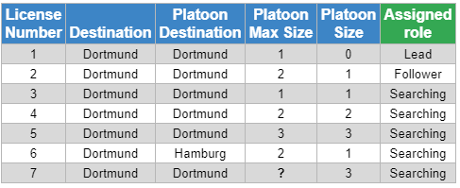
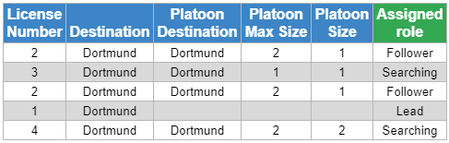
Random forest algorithm: Step 1. Bootstrap dataset

Slide 13
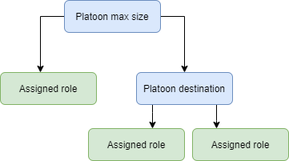
Random forest algorithm: Step 2. Build trees
1:N Random Trees

Slide 14
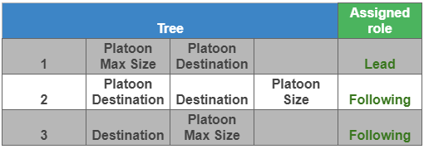
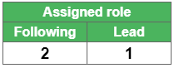

Random forest algorithm: Step 3. Final decision

Slide 15
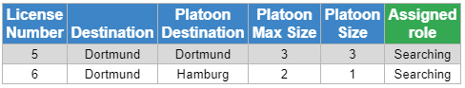
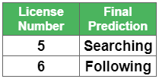
Random forest algorithm: Step 4. Check accuracy
Out-of-Bag Error

Slide 16
Conclusion
No control over the process
Can’t be overfitted
Handle large datasets with high dimensionality
Easy to use
Better performance as of decision trees

Slide 17
References
J.Frochte, “Ensemble Learning mittels Bagging und Boosting,” in Maschinelles Lernen. Grundlagen und Algorithmen in python, 3 überarbeitete und erweiterte, Carl Hanser Verlag GmbH & Co. KG, 2020, ch. 10, pp. 329–342.
Machine Learning Crash Course | Google Developers, accessed 07 Juni 2021, <https://developers.google.com/machine-learning/crash-course/>

Slide 18

Questions?
The image from https://www.ed-itsolutions.com/questions-like-answered

